Slide 1
Data Preprocessing & Visualization
Session : (Pandas)

Slide 2
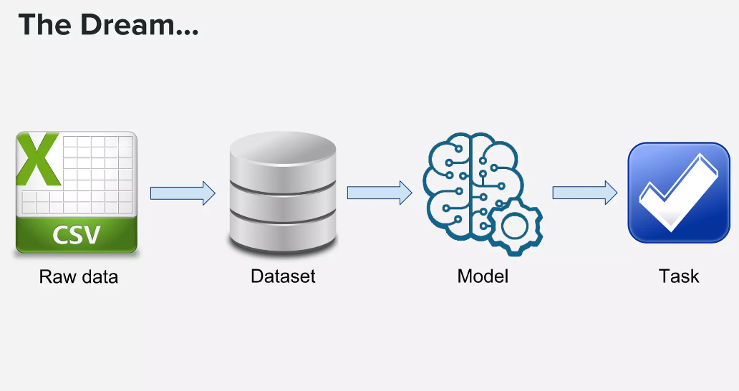

Slide 3
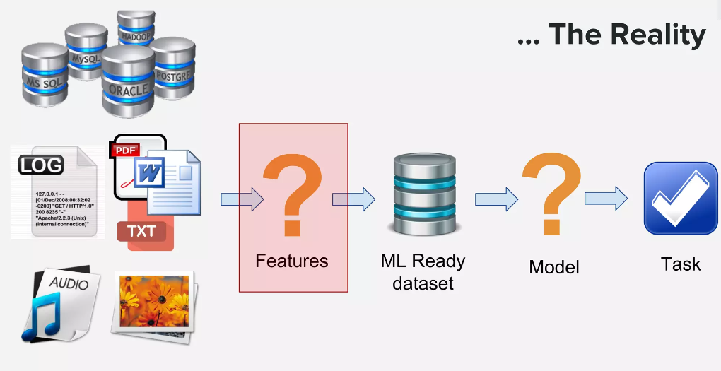

Slide 4
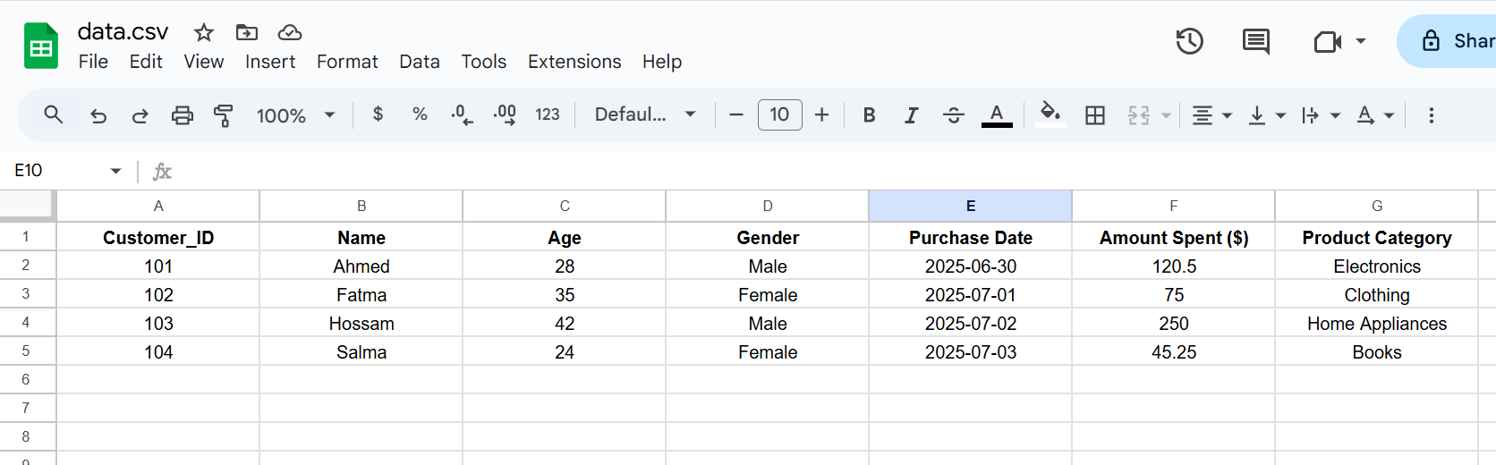
What is Data?
Data is any kind of raw information collected from the real world.
It can be numbers, text, images, or signals — anything that helps us describe or understand a situation.
Why is Data Important?
On its own, data is just raw numbers or facts. But when we organize, analyze, and interpret it — we can extract valuable insights, solve problems, and make better decisions.

Slide 5
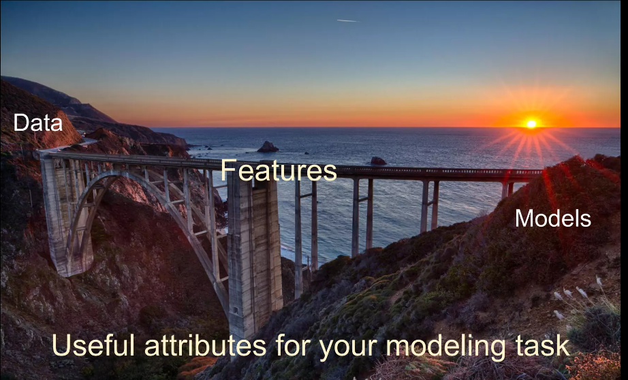
“At the end of the day, some machine learning projects succeed and some fail. What makes the difference?
Easily the most important factor is the features used.”
— Prof. Pedro Domingos

Slide 6
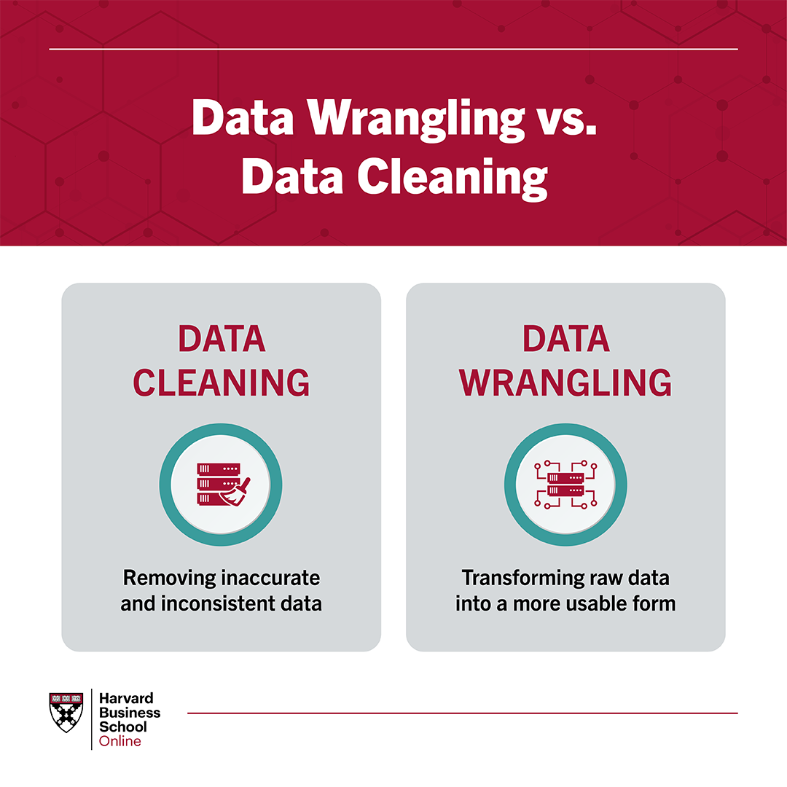
Data cleaning and wrangling takes up 80% of the data science workflow
Quality over quantity

Slide 7
🧹 Data Cleaning:
"Think of it like cleaning your room before organizing it. Data Cleaning is all about making sure the data is:
Correct
Consistent
Free of errors
Typical tasks include:
Handling missing values
Fixing incorrect entries
Standardizing formats (e.g., 'Yes', 'yes', 'Y' → all become 'Yes')
The goal is to make your dataset trustworthy."
Data Wrangling:
"Now that your data is clean, you move on to preparing it for analysis or modeling — this is Wrangling. Data Wrangling is about transforming, reshaping, and organizing your data.
It includes tasks like:
Converting data types (e.g., string to datetime)
Merging datasets
Renaming or reordering columns
Creating new columns or dropping irrelevant ones
Reshaping data using techniques
In short:
Cleaning = Fixing the data
Wrangling = Reshaping the data

Slide 8
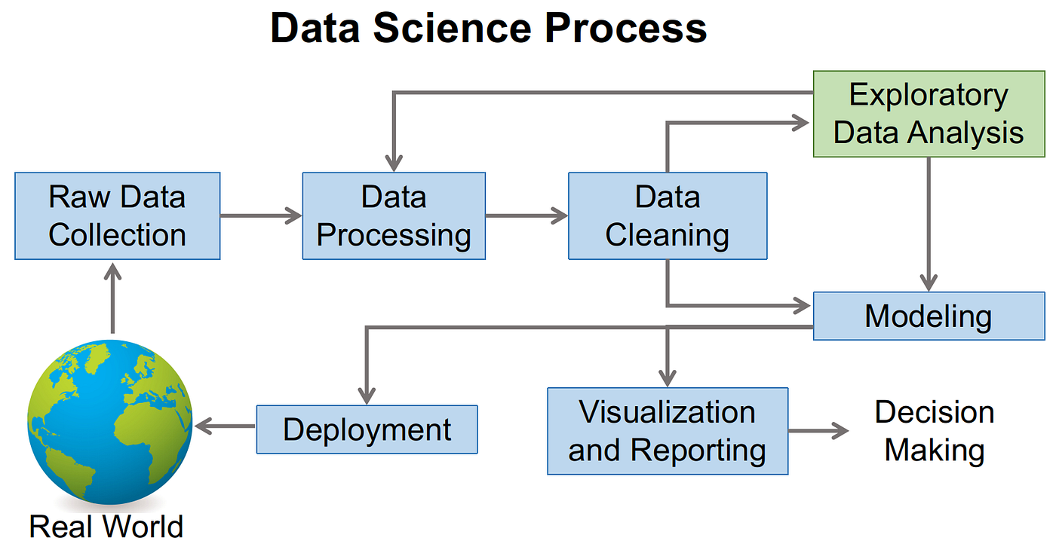

Slide 9
Data Preprocessing
Feature Transformations
Data Cleaning or Cleansing
Work with Missing data
Work with Categorical data
Detect and Handle Outliers
Split data to Train and Test Sets
Deal with Imbalanced classes
Feature Scaling
Feature Engineering and Extraction
Domain knowledge features (age , wh, BMI)
Date and Time features
String operations
Web Data
Geospatial features
Eng: Baraa slides

Slide 10
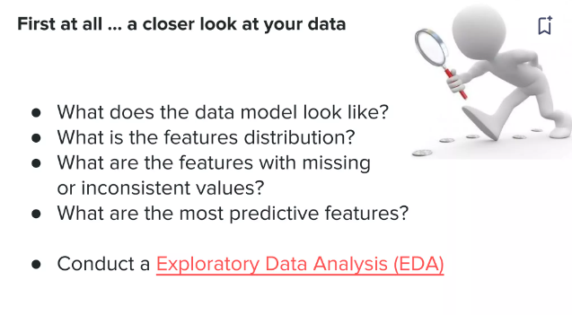

Slide 11


Exploratory Data Analysis (EDA)

Slide 12
Exploratory Data Analysis (EDA)
is a crucial step in the machine learning process that involves visually and statistically analyzing the data
to gain insights, understand its characteristics, and identify patterns or trends,
And to make informed decisions about data preprocessing, feature engineering, and model selection

Slide 13
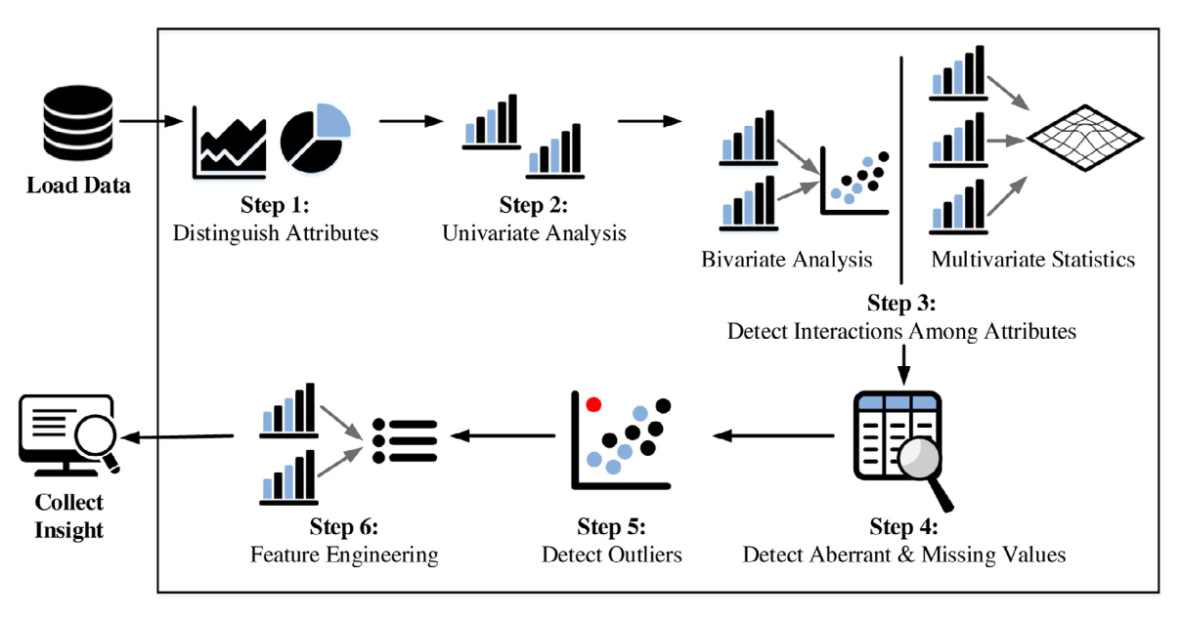
Exploratory Data Analysis overview
numeric + numeric
num + categorical
categorical +categorical

Slide 14
Why EDA is important in the machine learning process?
In general, EDA is a critical step in the machine learning process as it helps in :
Understanding the data
Assessing data quality
Guiding feature engineering
Informing model selection
Effectively communicating results

Slide 15
Common steps for EDA:
Data Collection:
Load and import the dataset into a DataFrame for analysis.
Using Python libraries such as Pandas, NumPy
2. Data Inspection:
Get an overview of the data, check for missing values, data types, and basic statistics.
Using DataFrame methods like info(), head(), tail(), and describe()

Slide 16
Common steps for EDA:
3. Data Cleaning and wrangling:
Imputing missing values, removing or correcting outliers, and addressing any data quality issues that may impact the accuracy of the analysis.
Using Pandas and NumPy libraries:
For example, you can use dropna(), fillna(), or interpolate() to handle missing values, and use visualizations to detect and handle outliers.

Slide 17
Common steps for EDA:
4. Data Visualization:
Create visualizations for data exploration to explore the data and identify patterns, trends, and relationships that help in gaining insights from the data.
Using Matplotlib, Seaborn, or Plotly libraries:
You can create various types of plots such as bar charts, histograms, scatter plots, box plots, heatmaps, and more to visualize the data and identify patterns, trends, and relationships.

Slide 18
Common steps for EDA:
5. Data Descriptive Statistics:
Calculate descriptive statistics for the data and gain a quantitative understanding of its distribution and characteristics such as mean, median, mode, standard deviation, and other relevant measures.
Using Pandas methods like mean(), median(), mode(), std(), and var()

Slide 19
Common steps for EDA:
6. Feature Analysis:
Analyze individual features (columns) in the dataset to understand their distributions, relationships with the target variable (if applicable), and identify any potential interactions or correlations.
Using libraries like SciPy or Statsmodels for statistical tests and Matplotlib or Seaborn for visualizations.

Slide 20
Common steps for EDA:
7. Feature Engineering
Improving the performance of the machine learning models using domain knowledge and insights gained from EDA to perform feature engineering, which may involve:
Selecting relevant features
Creating new features,
Transforming existing features
It involves transforming the data in a way that makes it more suitable for modeling, by extracting relevant information, reducing noise, and improving the representation of the underlying patterns in the data.

Slide 21
EDA use case
on clothing reviews
https://www.kaggle.com/code/wonduk/eda-lstm-classification-on-clothing-reviews
More EDA use case https://www.kaggle.com/wonduk/code

Slide 22
Agenda:
1 | Introduction to Pandas
2 | Data Manipulation with Pandas
3 | Practical Examples

Slide 23
Introduction to Pandas

Slide 24
Introduction to Pandas
What is Pandas?
Pandas is an open-source data analysis and data manipulation library built on top of Numpy. It provides high-level data structures and functions designed to make data analysis fast and easy in Python.
Pandas is widely used in data science, finance, statistics, and many other fields for tasks like data cleaning, transformation, and analysis.

Slide 25
Introduction to Pandas
Key Features of Pandas
Series and DataFrames: Pandas introduces two primary data structures: Series (one-dimensional) and DataFrame (two-dimensional), which are used to store and manipulate data.
Data Alignment: Pandas automatically aligns data by its labels, making it easy to perform arithmetic operations on data sets with different indexes.
Handling Missing Data: Pandas provides methods for detecting, filling, and dropping missing data, which is essential for cleaning datasets.
Powerful Data Grouping and Aggregation: Pandas supports grouping data, aggregating results, and applying custom functions using the groupby() functionality.
Flexible Data Reading/Writing: Pandas can read from and write to various file formats, including CSV, Excel, SQL databases, and more.

Slide 26
Pandas
We will use pandas to:
Read in data from Excel.
Manipulate data in spreadsheet.
Visualize data (we will also use another Python package called ggplot to do this).
Filter and aggregate data from spreadsheet using SQL

Slide 27
Data Manipulation with Pandas
Data manipulation is a core aspect of data analysis. Pandas provides various tools and functions to manipulate data efficiently.

Slide 28
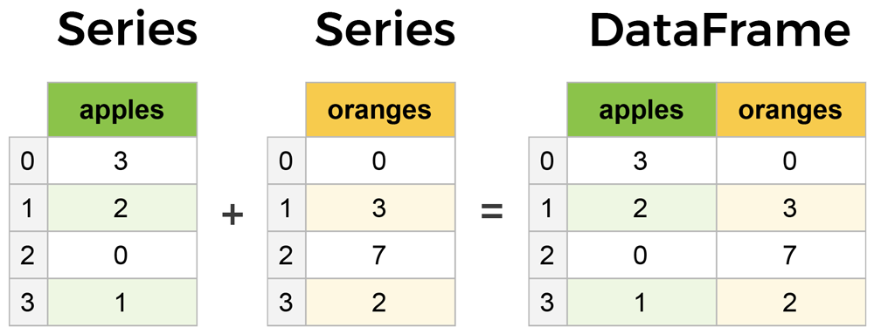
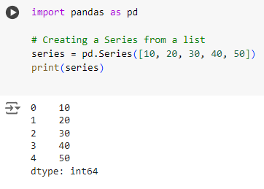
Creating Pandas Data Structures
Creating a Pandas Series
A Series is a one-dimensional labeled array capable of holding any data type. It is similar to a column in a spreadsheet.

Slide 29
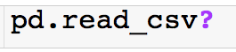
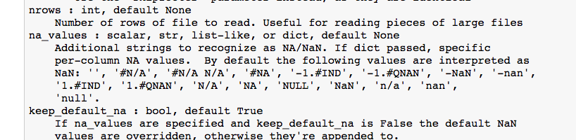
Missing Data

Slide 30
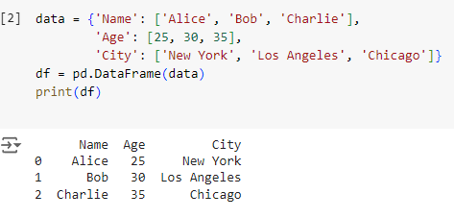
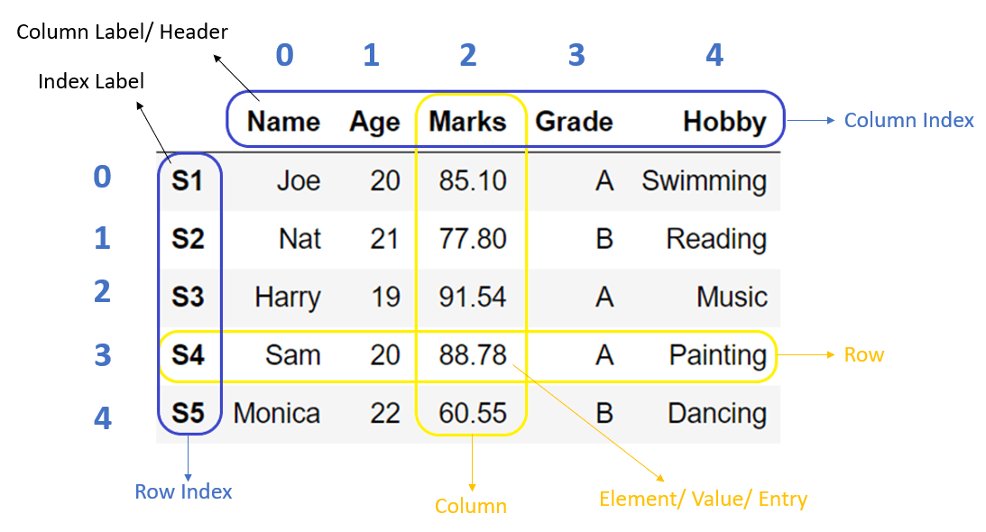
Creating Pandas Data Structures
Creating a DataFrame from a Dictionary
import pandas as pd
A DataFrame is a two-dimensional labeled data structure with columns of potentially different types. It is similar to a table in a database or a data frame in R.

Slide 32
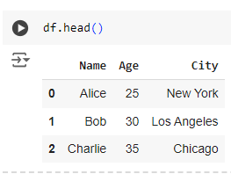
Viewing and Inspecting Dat
Viewing the First Few Rows
The head() method returns the first five rows of the DataFrame. This is useful for quickly examining the top of a dataset.

Slide 33
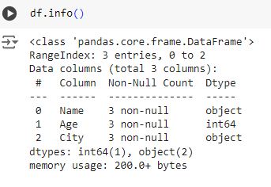
اخدت نظرة اولية على :
عدد الاعمدة
عدد ال rows
datatype
count of missing data
Viewing and Inspecting Data
Getting DataFrame Information
The info() method provides a summary of the DataFrame, including the number of non-null entries and the data type of each column.

Slide 34
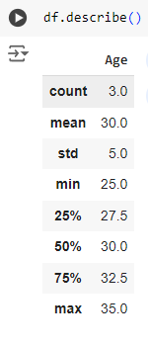
Viewing and Inspecting Dat
Describing Statistical Information
The describe() method generates descriptive statistics, such as mean, standard deviation, min, and max, for numerical columns.

Slide 35
"Whenever you open a new dataset, your first 5 minutes should include these five commands: df.shape
df.columns
df.info()
df.describe()
df.head() These will give you a quick understanding of the data’s structure, size, types, and any missing values — before you do any cleaning or analysis."
Eng: Baraa slides

Slide 36
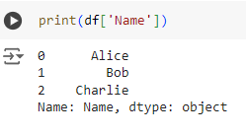
Selecting and Filtering Data
Selecting Columns
You can select a single column from a DataFrame using the column name. This returns a Series object.

Slide 37
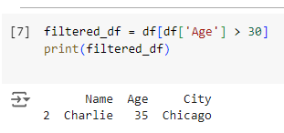
Selecting and Filtering Data
Filtering Rows Based on Condition
You can filter rows based on a condition. Here, only rows where the 'Age' column is greater than 30 are selected.

Slide 38
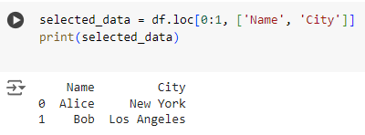
Selecting and Filtering Data
Selecting Specific Rows and Columns
The loc[] method is used for label-based indexing to select specific rows and columns. Here, rows with indices 0 and 1 and columns 'Name' and 'City' are selected.
loc[row , col]
go to code

Slide 39
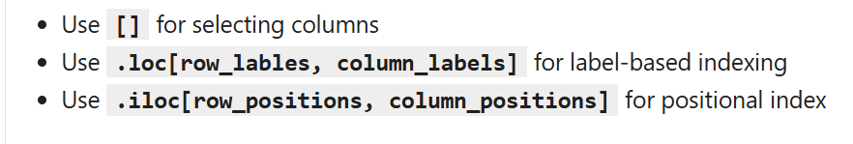
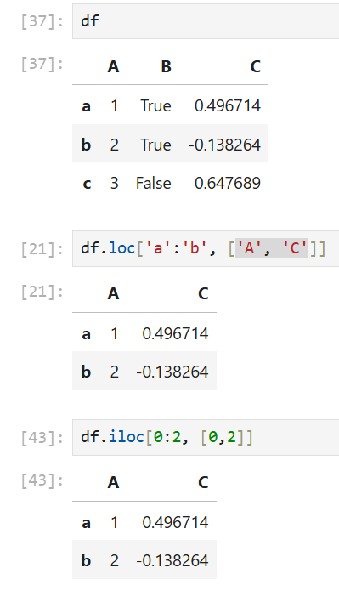

Slide 40
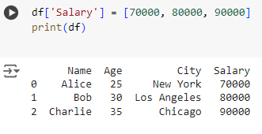
Modifying Data
Adding a New Column
A new column 'Salary' is added to the DataFrame with specified values. This is a common operation to add calculated fields or new data.

Slide 41
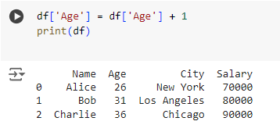
Modifying Data
Updating Column Values
This updates the values in the 'Age' column by adding 1 to each value. Pandas allows vectorized operations, making this efficient.

Slide 42
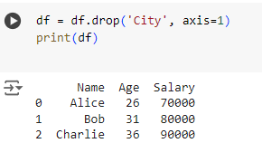
Modifying Data
Dropping Columns
The drop() method removes the 'City' column from the DataFrame. The axis=1 argument specifies that a column is being dropped.
axis{0 or ‘index’, 1 or ‘columns’}, default 0
Whether to drop labels from the index (0 or ‘index’) or columns (1 or ‘columns’).
Try: axis 0

Slide 43
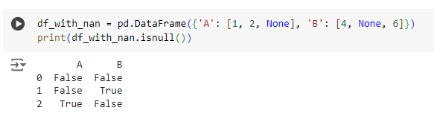
Handling Missing Data
Detecting Missing Values
The isnull() method detects missing values in the DataFrame and returns a DataFrame of the same shape with True or False values.

Slide 44
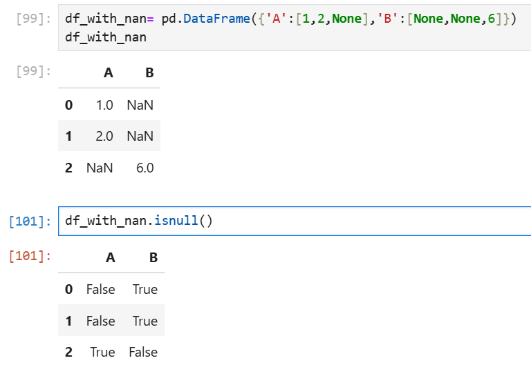
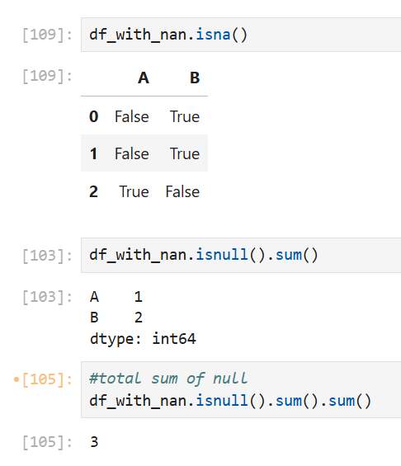

Slide 45
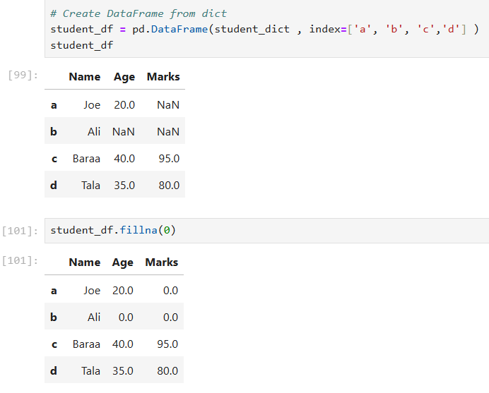
Handling Missing Data
Filling Missing Values
The fillna() method replaces missing values with a specified value, such as 0. This is useful for cleaning datasets before analysis.

Slide 46
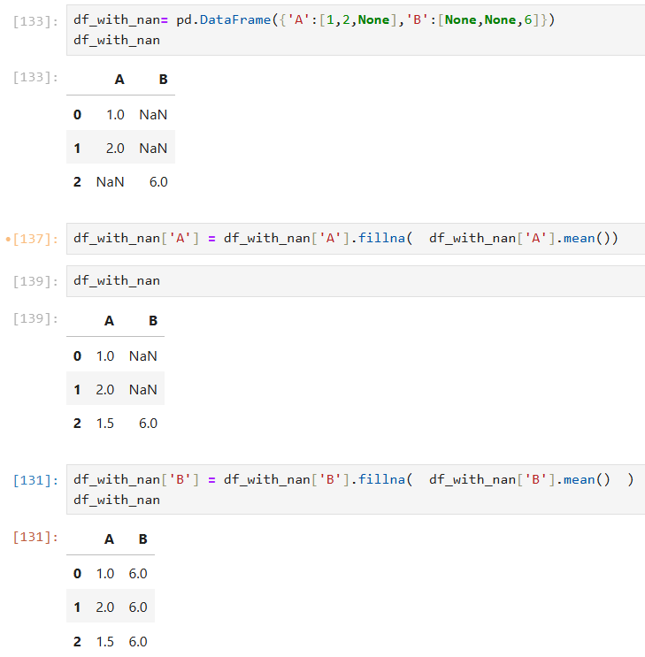

Slide 47
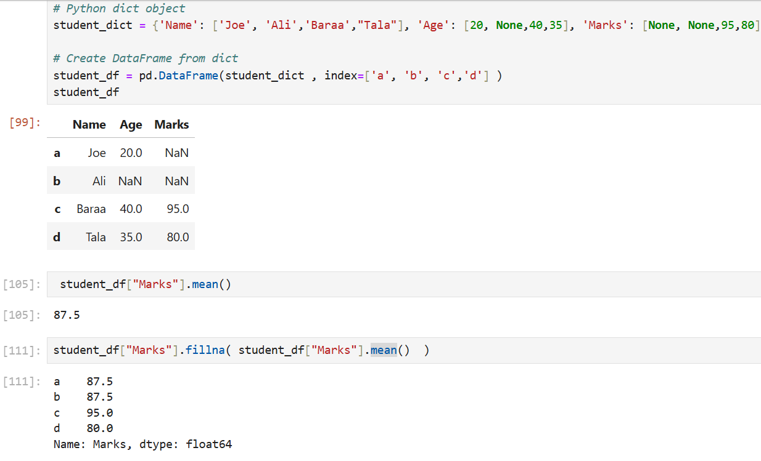

Slide 48
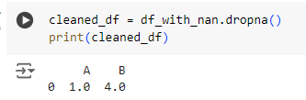
Handling Missing Data
Dropping Rows with Missing Values
The dropna() method removes rows with any missing values. This can be useful when working with datasets where missing values cannot be tolerated.
Try axis 1

Slide 49
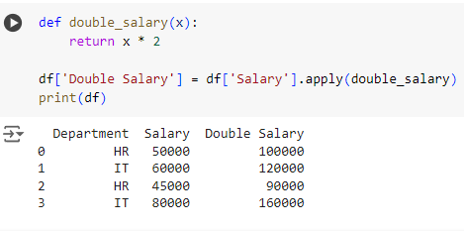
select salary,salary*2 from emp
Grouping and Aggregation
Applying Custom Functions with apply()
The apply() method is used to apply a custom function to each element in a column. Here, it doubles the salary for each employee.

Slide 50
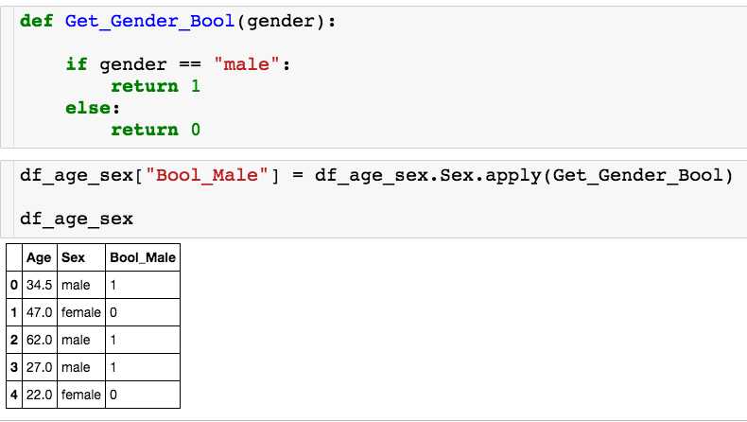
Using Apply
Let’s see how we can use apply with a custom function on a single column:
Calls Get_Gender_Bool once for each row.

Slide 51
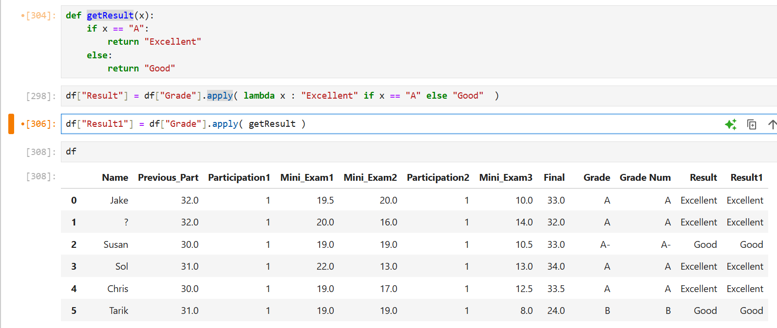

Slide 52
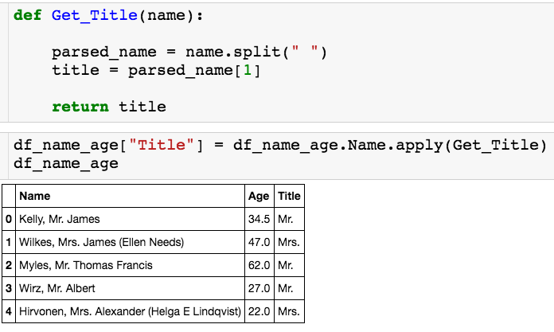
Using Apply
Last one:

Slide 53
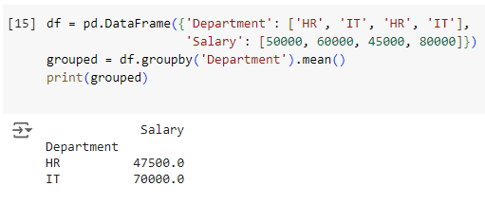
Grouping and Aggregation
Grouping Data and Calculating Mean
select avg(salary)
from users
group by Department
The groupby() method groups the data by a specified column and then calculates the mean salary for each department. This is commonly used for summarizing data.

Slide 54
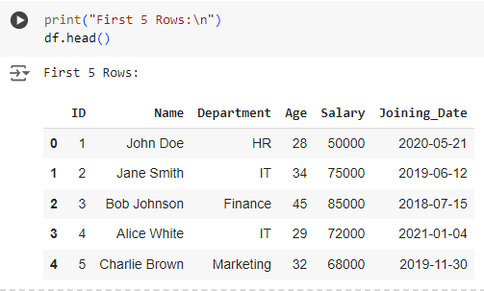
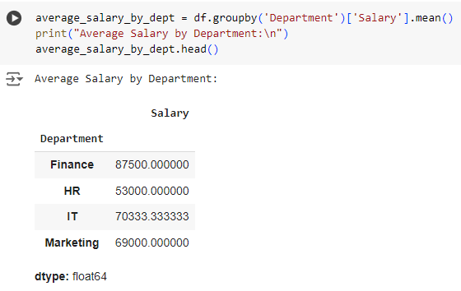
Practical Examples
Calculating the Average Salary by Department
The groupby() method groups the data by the 'Department' column and calculates the mean salary for each department using mean().

Slide 55
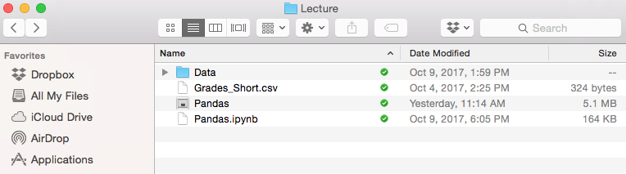
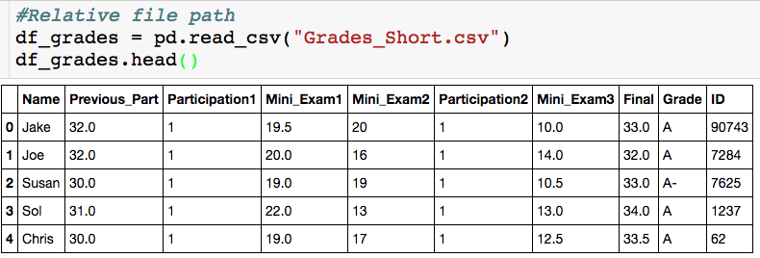
Reading in Data From Excel
Data file
Jupyter notebook

Slide 56
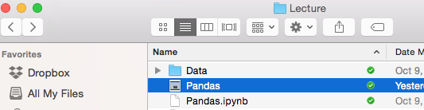
Reading in Data From Excel
Now Grades_Short.csv is in Data Folder
Jupyter notebook

Slide 57
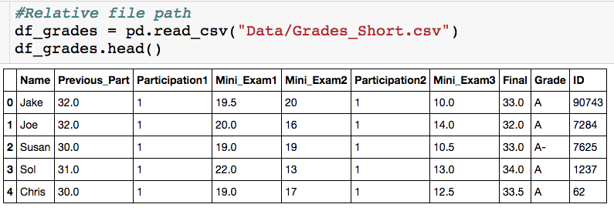
Reading in Data From Excel
Now Grades_Short.csv is in Data Folder
Jupyter Notebook
“/” separates directories

Slide 58
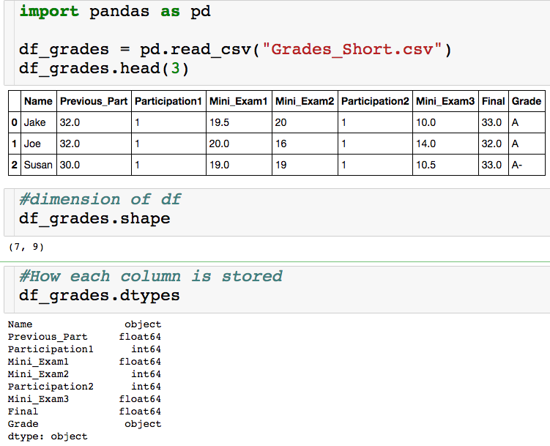
Basic Features
Think of this as a list
object = string
float64 = decimal
int64 = integer

Slide 59
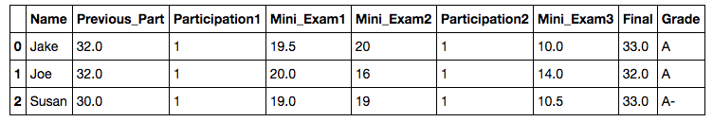
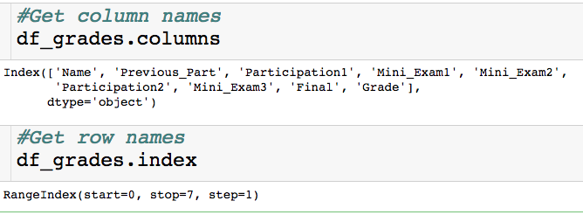
Basic Features
column names
row names = index

Slide 60
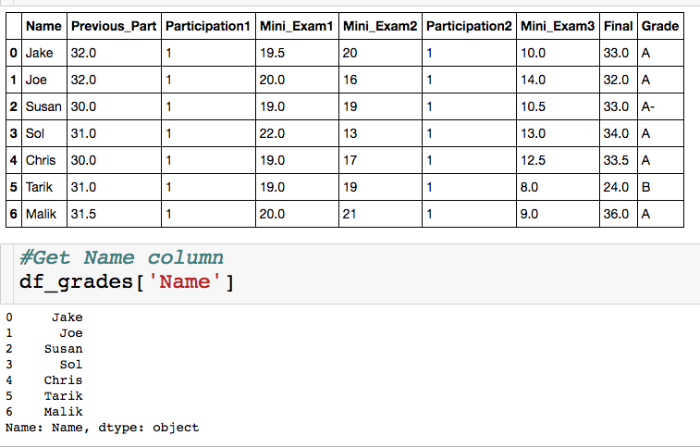
Selecting a Single Column
Between square brackets, the column must be given as a string
Outputs column as a series
A series is a one dimensional dataframe..more on this in the slicing section

Slide 61
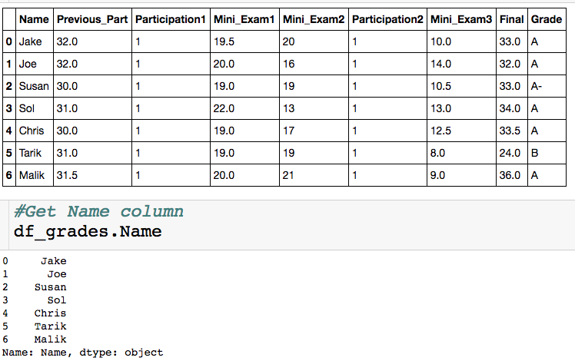
Selecting a Single Column
Exactly equivalent way to get Name column
+ : don’t have to type brackets or quotes
-: won’t generalize to selecting multiple columns,, won’t work if column names have spaces, can’t create new columns this way

Slide 62
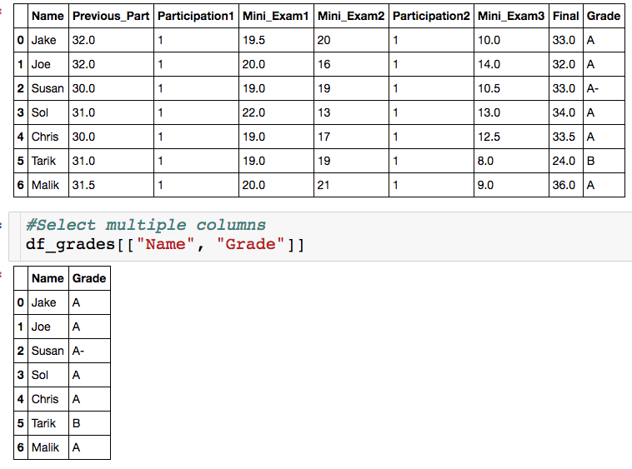
Selecting Multiple Columns
List of strings, which correspond to column names.
You can select as many column as you want.
Column don’t have to be contiguous.

Slide 63
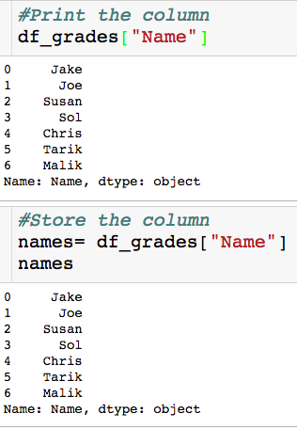
Storing Result
Why store a slice?
We might want/have to do our analysis is steps.
Less error prone
More readable
The variable name stores a series

Slide 64


Slicing a Series
Slice/index through the index, which is usually numbers
Picking out single element

Slide 65

Slicing a Series
Slice/index through the index, which is usually numbers
Picking out single element
Contiguous slice
non_inclusive

Slide 66

Slicing a Series
Slice/index through the index, which is usually numbers
Picking out single element
Contiguous slice
Arbitrary slice

Slide 67

Slicing a Data Frame
There are a few ways to pick slice a data frame, we will use the .loc method.
Access elements through the index labels column names
We will see how to change both of these labels later on

Slide 68

Slicing a Data Frame
Column name (string)
Pick a single value out.
Index label (number)

Slide 69

Slicing a Data Frame
Pick out entire row:
“pick out all columns”
first_row is a series

Slide 70

Slicing a Data Frame
Pick out contiguous chunk:
Endpoints are inclusive!
df_gredes.iloc[0:3 , 0:5]

Slide 71

Slicing a Data Frame
Pick out arbitrary chunk:

Slide 72

Built in Functions
How do I compute the average score on the final?

Slide 73


Built in Functions
How do I compute the average score on the final?
Built in mean() method

Slide 74

Built in Functions
How do I compute the highest Mini Exam 1 score?

Slide 75

Built in Functions
I can actually get all key stats for numeric columns at once with the describe() method:
summary_df is a dataframe!

Slide 76

Built in Functions
I can actually get all key stats for numeric columns at once with the describe() method:

Slide 77

Built in Functions
Other useful built in methods:
value_count(): Gives a count of the number of times each unique value apears in the column. Returns a series where indices are the unique column values.

Slide 78

Built in Functions
Other useful built in methods:
value_count(): Gives a count of the number of times each unique value appears in the column. Returns a series where indices are the unique column values.

Slide 79

Built in Functions
Other useful built in methods:
unique(): Returns an array of all of the unique values.

Slide 80


Attributes vs. Methods
When do I a put a ()?

Slide 81
Attributes vs. Methods
When do I a put a ()?
dataframe attributes
dataframe methods

Slide 82
Attributes vs. Methods
When do I a put a ()?
dataframe attributes
dataframe methods
Require computation for output
Features of dataframe

Slide 83


Creating New Columns
Let’s create a useless new column of all 1s:

Slide 84



Creating New Columns
We can also create column as function of other column. The Final was worth 36 points, let’s create a column for each student’s percentage.

Slide 85

Deleting Columns

Slide 86

Deleting Columns

Slide 87


Missing Data
Not that different columns have different indicators for missing data.

Slide 88


Missing Data
We can replace the missing data with a true NaN (right now everything is just a string).

Slide 89

Missing Data
List of strings specifying which values are missing.

Slide 90

Missing Data
List of strings specifying which values are missing.
Special NaN value (from numpy package), which is not a string.

Slide 91

Missing Data
We know “NaN” and “not available” are missing data points, but what about -1?

Slide 92
Missing Data
We know “NaN” and “not available” are missing data points, but what about -1?
For the Participation1 column the -1 is probably missing data.
For the Temp column, the -1 is likely not missing data, since -1 is a valid temperature.
For each column, we can specify exactly which values correspond to missing data.

Slide 93
Missing Data
Curly brackets

Slide 94
Missing Data
Column name as string
NaN value

Slide 95
Missing Data
Column name as string
NaN value
“For column Participation1, replace all -1s with a NaN.”

Slide 96

Missing Data
Notice that the -1 was replaced only in Participation1 column

Slide 97
Comparing Approaches
Approach 1:
Does a global search and replace in all columns.
Approach 2:
Allows you to specify column by column the values that should be replaced with NaN.

Slide 98
Benefiting of Having NaNs
Have common symbol for where there is missing data
Good for you and good for others looking at your code/data
These entries will be ignored if you try to compute means of columns with NaNs.
We can easily get rid of column/rows with missing data
We can easily replace the missing values with the mean of the column, for example.

Slide 99


Isnull() Method
The isnull() method lets you check where the NaNs are:

Slide 100



Slide 101


Slide 102

Isnull() Method
The isnull() method lets you check where the NaNs are:

Slide 103

Dropna() Method
How do I get rid of all rows with NaN?

Slide 104
Practical Examples

Slide 105

Practical Examples
We'll load this CSV file into a Pandas DataFrame and perform various data manipulation tasks

Slide 106
Practical Examples
Viewing the First Few Rows of the DataFrame
The head() method displays the first five rows of the DataFrame, which is useful for getting a quick look at the data.

Slide 107

Practical Examples
Displaying Basic Information About the DataFrame
The info() method provides a summary of the DataFrame, including the number of non-null values, data types, and memory usage.

Slide 108

Practical Examples
Calculating Basic Statistics for Numerical Columns
The describe() method generates descriptive statistics such as mean, standard deviation, and percentiles for numerical columns.

Slide 109


Slide 110

Practical Examples
Filtering Employees by IT Department
This code filters the DataFrame to show only employees who work in the IT department using a condition on the 'Department' column.

Slide 111

Practical Examples
Adding a New Column for Salary After a 5% Raise
A new column is added to the DataFrame by multiplying the 'Salary' column by 1.05 to reflect a 5% salary increase.

Slide 112

Practical Examples
Sorting Employees by Age in Descending Order
https://pandas.pydata.org/docs/reference/api/pandas.DataFrame.sort_values.html
The sort_values() method sorts the DataFrame by the 'Age' column in descending order, showing the oldest employees first.

Slide 113

Practical Examples
Calculating the Number of Employees in Each Department
The value_counts() method counts the number of occurrences of each unique value in the 'Department' column, showing how many employees are in each department.

Slide 114

Practical Examples
Finding Employees Who Joined After 2020
This converts the 'Joining_Date' column to datetime format and filters the DataFrame to find employees who joined after January 1, 2020.

Slide 115


Practical Examples
Saving the Filtered DataFrame to a New CSV File
The to_csv() method saves the filtered DataFrame (recent_joins) to a new CSV file named 'recent_joins.csv'. The index=False argument excludes the row index from the CSV file.
Summary

Slide 116
Data Preprocessing
Feature Transformations
Data Cleaning or Cleansing
Work with Missing data
Detect and Handle Outliers
Deal with Imbalanced classes
Work with Categorical data
Feature Scaling
Split data to Train and Test Sets
Feature Engineering and Extraction
Domain knowledge features (age , wh, BMI)
Date and Time features
String operations
Web Data
Geospatial features
Eng: Baraa slides

Slide 117
Feature Transformations
Data Cleaning or Cleansing
Work with Missing data
Detect and Handle Outliers
Deal with Imbalanced classes
Work with Categorical data
Feature Scaling
Split data to Train and Test Sets
Eng: Baraa slides

Slide 118




Data Cleaning or Cleansing
Cleaning data is the process of preparing the dataset
for analysis. It is very important because the accuracy
of machine learning or data mining models are affected
because of poor quality of data.
So, data scientists spend a large amount of their time
cleaning the dataset and transform them into a format
with which they can work with. In fact, data scientists
spend 80% of their time cleaning the data.
Example of problems
Columns can have missing data indicators like xx and ?.
Height column can have value of 0.
Weight column can have negative values.
…
Eng: Baraa slides

Slide 119
Data Problems:
to identify and resolve any quality issues with your data
Data Constraints Problems
Text and Categorical Data Problems
Data Uniformity Problems

Slide 120
Data Constraints Problems:
Data Type Constraints:
Problem: Incorrect data types in columns.
Solutions: Convert to the correct data type.
Example in Action: A revenue_usd column that contains values like "$1,000" as strings instead of numeric data types.
Data Range Constraints:
Problem: Values outside the expected range.
Solutions: Check for typos, drop rows, set to min/max, or impute.
Example in Action: A gpa column with values exceeding the valid range, such as a GPA of 5.2.
Uniqueness Constraints:
Problem: Duplicates in the data.
Solutions: Keep one, merge non-exact duplicates, or infer categories.
Example in Action: Duplicate rows with the same name and phone_number columns but different height_cm values.

Slide 121
Text and Categorical Data Problems:
Membership Constraints for Categorical Data:
Problem: Inconsistent categories.
Solutions: Drop rows, remap categories, or infer correct categories.
Example in Action: Two different entries for "New York" “NYC” , “New york”in the city column, causing inconsistency.
Length Violation for Text Data:
Problem: Text length doesn't match expectations.
Solutions: Drop rows or set affected observations to missing.
Example in Action: A US phone_number column with entries that have 9 characters instead of the expected 14.
Text Data with Inconsistent Formatting:
Problem: Text data not following a standard format.
Solutions: Drop rows or set affected observations to missing.
Example in Action: Inconsistent date formats like "dd-mm-yyyy" and "mm-dd-yyyy" in a date_of_birth column.

Slide 122
Data Uniformity Problems:
Unit Uniformity for Numeric Columns:
Problem: Inconsistent units in numeric columns.
Solutions: Drop rows, standardize units, or apply domain-specific rules.
Example in Action: A temperature column in Celsius with extremely high or low values that are outside the expected range.
Unit Uniformity for Date Columns:
Problem: Inconsistent date formats.
Solutions: Standardize formats, drop rows, or apply domain-specific rules.
Example in Action: A birthday column containing dates in various formats, such as "dd-mm-yyyy" and "mm-dd-yyyy."
Crossfield Validation for Numeric or Date Columns:
Problem: Inconsistent or incorrect relationships between columns or between date columns.
Solutions: Drop rows or apply domain-specific validation rules.
Example in Action: Total flight bookings per class not adding up to the total recorded bookings.
Example in Action: A date_of_birth column not corresponding with the calculated age based on other date columns.

Slide 123

Data Cleaning (First Step in Preprocessing) "Garbage in → Garbage out"
Why Cleaning First?
Raw data is always messy.
ML models are sensitive to errors.
Cleaning builds the foundation for all later steps.
Example: You can’t cook with dirty vegetables → first wash & clean.
Data Problems Detection – Quick Checklist
Inspect structure → shape, info, head()
Find missing values → isnull().sum() (we see later)
Detect duplicates → duplicated().sum()
Spot outliers → describe(), boxplot() (we see later)
Check category consistency → unique()
Catch invalid values → logical rules (Age < 0, Salary < 0)
Clean text fields → str.strip(), str.lower()
Always diagnose your dataset before training
→ “Bad data in → bad model out.”
→ "Garbage in → Garbage out"

Slide 124
Quick Data Inspection
df.shape # rows & columns
Tells you (rows, columns).
Example: (2000, 10) → 2000 records, 10 features.
Helps to know if dataset is small, medium, or big.
df.head() # first rows
Shows sample records.
Detect strange values early.
Example: Last row has Age = 999 → suspicious.
df.info() # data types
Shows column names, data types (int, float, object, datetime).
Detects mismatches:
Age stored as “object” instead of “int”.
Date stored as string instead of datetime.
df.describe() # summary stats
Mean, min, max, std for each numeric column.
Quickly spot impossible values (e.g., Height min = -10).
💡 Why Important?
Like a doctor’s first check-up: weight, temperature, blood pressure.
Before deep analysis, you need to know the “overall health” of the dataset.
Like a doctor’s first check-up: weight, temperature, blood pressure.
Before deep analysis, you need to know the “overall health” of the dataset.

Slide 125
Feature Transformations
Data Cleaning or Cleansing
Work with Missing data
Detect and Handle Outliers
Deal with Imbalanced classes
Work with Categorical data
Feature Scaling
Split data to Train and Test Sets
Eng: Baraa slides

Slide 126

Work with Missing data
Check Missing Data
Drop Missing Data
Fill Missing data with Pandas
Fill Missing data with Sklearn SimpleImputer
Fill Missing data with Sklearn KNNImputer
Eng: Baraa slides

Slide 128



Check missing data
In Pandas missing data is represented by two value: None/NaN
we use a function isnull() to check even if NAN is true/false
we use a function isnull() to check number of nan in each column
Eng: Baraa slides

Slide 129
Drop Missing Data
1.When the data goes missing on 70–80 percent of the variable:
dropping the variable should be considered
2. When the data goes missing on 1–5 percent of the variable
dropping missing values only should be considered
dropna( axis=0, how="any", subset=None, inplace=False)
axis: possible values are {0 or ‘index’, 1 or ‘columns’}, default 0. If 0, drop rows with null values. If 1, drop columns with missing values.
how: possible values are {‘any’, ‘all’}, default ‘any’. If ‘any’, drop the row/column if any of the values is null. If ‘all’, drop the row/column if all the values are missing.
subset: specifies the rows/columns to look for null values.
inplace: a boolean value. If True, the source DataFrame is changed and None is returned
Eng: Baraa slides

Slide 130


Dropping rows/columns with at least 1 null value
Rows
columns
Eng: Baraa slides

Slide 131

Work with Missing data
Work with Missing data
Check Missing Data
Drop Missing Data
Fill Missing data with Pandas
Fill Missing data with Sklearn SimpleImputer
Fill Missing data with Sklearn KNNImputer
Check Missing Data
Drop Missing Data
Fill Missing data with Pandas
Fill Missing data with Sklearn SimpleImputer
Fill Missing data with Sklearn KNNImputer
Eng: Baraa slides

Slide 132
Fill Missing data with Pandas
Filling the missing data with the mean or median value if it’s a numerical variable.
Filling the missing data with the median value only if it’s a numerical variable with outliers
Filling the missing data with mode if it’s a categorical value.
Eng: Baraa slides

Slide 133

Work with Missing data
Check Missing Data
Drop Missing Data
Fill Missing data with Pandas
Fill Missing data with Sklearn SimpleImputer
Fill Missing data with Sklearn KNNImputer
Eng: Baraa slides

Slide 134

Work with Missing data
Check Missing Data
Drop Missing Data
Fill Missing data with Pandas
Fill Missing data with Sklearn SimpleImputer
Fill Missing data with Sklearn KNNImputer
Eng: Baraa slides

Slide 135


Work with Missing data
Check Missing Data
Drop Missing Data
Fill Missing data with Pandas
Fill Missing data with Sklearn SimpleImputer
Fill Missing data with Sklearn KNNImputer
Eng: Baraa slides

Slide 136
Feature Transformations
Data Cleaning or Cleansing
Work with Missing data
Detect and Handle Outliers
Deal with Imbalanced classes
Work with Categorical data
Feature Scaling
Split data to Train and Test Sets
Eng: Baraa slides

Slide 137

Detect and Handle Outliers
هيخربو الmean
In statistics, an outlier is a data point that differs significantly
from other observations.
An outlier may be due to variability in the measurement or it
may indicate experimental error, the latter are sometimes
excluded from the data set.
An outlier can cause serious problems in statistical analyses.
Eng: Baraa slides

Slide 138


Detect Outliers
Detect Outliers with Visualization.
Detect and Handle Outliers with IQR.
Handle Outliers with business value
Eng: Baraa slides

Slide 139
IQR interquartile range
range between Q1 and Q3
 | 1q

Slide 140

20- 1.5*20
= -10
40 + 1.5*20
= 70
20
40

Slide 141

Detect and Handle Outliers
Detect Outliers with Visualization.
Detect and Handle Outliers with IQR.
Handle Outliers with business value
Eng: Baraa slides

Slide 142

Detect and Handle Outliers with Business value
Essentially, instead of removing outliers from the data.
you change their values to something more representative of your data set , value related to the business of your data , that called business value.
For example the “Alice in Wonderland” movie duration in this dataset is 557 Minutes which is an outlier , so we can replace this outlier value with its real duration 75 Minute
Detect Outliers with Visualization.
Detect and Handle Outliers with IQR.
Handle Outliers with business value
Eng: Baraa slides

Slide 143
Feature Transformations
Data Cleaning or Cleansing
Work with Missing data
Detect and Handle Outliers
Deal with Imbalanced classes
Work with Categorical data
Feature Scaling
Split data to Train and Test Sets
Eng: Baraa slides

Slide 144

Deal with Imbalanced classes
Imbalanced classes are a common problem in machine learning classification where there are an unbalanced ratio of
observations in each class. Class imbalance can be found in many different areas including medical diagnosis, spam
filtering, and fraud detection.
class 2
سلبي
class 1
ايجابي
Eng: Baraa slides

Slide 145


Deal with Imbalanced classes
Data Leakage
Down-sampling or Under-sampling Majority Class
Generate Synthetic Samples with SMOTE
Eng: Baraa slides

Slide 146


Deal with Imbalanced classes
Down-sampling or Under-sampling Majority Class
Generate Synthetic Samples with SMOTE
Eng: Baraa slides

Slide 147
Oversampling methods duplicate or create new synthetic examples in the minority class, whereas under sampling methods delete or merge examples in the majority class.
Both types of resampling can be effective when used in isolation, although can be more effective when both types of methods are used together.
Deal with Imbalanced classes ( Combination )
Eng: Baraa slides

Slide 148

Deal with Imbalanced classes
Eng: Baraa slides

Slide 149
Feature Transformations
Data Cleaning or Cleansing
Work with Missing data
Detect and Handle Outliers
Deal with Imbalanced classes
Feature Scaling
Work with Categorical data
Split data to Train and Test Sets
Eng: Baraa slides

Slide 150
Feature Scaling
It is common to scale data prior to fitting a machine learning model.
This is because data often consists of many different input variables or features (columns) and each may have a different range of values or units of measure, such as feet, miles, kilograms, dollars, etc.
If there are input variables that have very large values relative to the other input variables, these large values can dominate or skew some machine learning algorithms.
The result is that the algorithms pay most of their attention to the large values and ignore the variables with smaller values.
This includes algorithms that use a weighted sum of inputs :
like linear regression
logistic regression
artificial neural networks
as well as algorithms that use distance measures between examples such as :
k-nearest neighbors
support vector machines.
age >> 18 to 70
salary >> 10000 to 500000
Eng: Baraa slides

Slide 151


Feature Scaling
Normalization with Sklearn MinMaxScaler.
Standardizing data with StandardScaler.
Eng: Baraa slides

Slide 152


Feature Scaling
Normalization with Sklearn MinMaxScaler.
Standardizing data with StandardScaler.
Eng: Baraa slides

Slide 153
Normalization with Sklearn MinMaxScaler.
it is the simplest method and consists of rescaling the range of features to scale the range in [0, 1]
Standardizing data with StandardScaler.
Feature standardization makes the values of each feature in the data have zero mean and unit variance.
Eng: Baraa slides

Slide 154

Feature Scaling ( Robust Scalar )
Eng: Baraa slides
Sometimes an input variable may have outlier values. These are values on the edge of the distribution that may have a low probability of occurrence yet are overrepresented for some reason.
Outliers can skew a probability distribution and make data scaling using standardization difficult as the calculated mean and standard deviation will be skewed by the presence of the outliers.
One approach to standardizing input variables in the presence of outliers is to ignore the outliers from the calculation of the mean and standard deviation, then use the calculated values to scale the variable. This is called robust standardization or robust data scaling.
This can be achieved by calculating the median (50th percentile) and the 25th and 75th percentiles.
The values of each variable then have their median subtracted and are divided by the interquartile range (IQR) which is the difference between the 75th and 25th percentiles

Slide 155
❌ Common Mistakes (Feature Scaling):
Applying Feature Scaling on the entire dataset before splitting into train and test sets → This can cause data leakage, as information from the test set may influence the scaling parameters (like mean and standard deviation).
Forgetting to apply the same scaler (fitted on training data) to the test data
⚠️ Potential Mistakes (Imbalanced Classes):
Misusing Under-sampling → Loss of valuable information! → Removing too many samples from the majority class can result in losing important patterns in the data.
Using SMOTE before splitting the data → Data Leakage! → If you apply SMOTE before splitting, synthetic samples are generated using information from the entire dataset, including the test set — which causes leakage.

Slide 156
Feature Transformations
Data Cleaning or Cleansing
Work with Missing data
Detect and Handle Outliers
Deal with Imbalanced classes
Feature Scaling
Work with Categorical data
Split data to Train and Test Sets
Eng: Baraa slides

Slide 157
nominal > غير مرتبة >> one hot encoding, binary encoding
ordinal >> مرتبة >> label encoding

Slide 158

Work with Categorical ordinal data ( Label Encoder )
Label encoding converts the data in machine-readable form, but it assigns a unique number(starting from 0) to each class of data , in a sequence ordinal manner.
To use label encoding, your data should must have inherent order in its logic
We can’t use it with nominal data ( non – ordered ).
An attribute having output classes Mexico, Paris, Dubai. On Label Encoding, this column lets Mexico is replaced with 0, Paris is replaced with 1, and Dubai is replaced with 2.
With this, it can be interpreted that Dubai has high priority than Mexico and Paris while training the model, But actually, there is no such priority relation between these cities here.
Work with Ordinal Features with pandas map method.
Eng: Baraa slides

Slide 159


Work with Categorical Nominal data (ONE-HOT Encoder / Binary Encoding)
Work with Ordinal Features with pandas map method.
Work with Nominal Features with pandas get_dummies method.
Work with Nominal Features with sklearn OneHotEncoder method.
Eng: Baraa slides

Slide 160
Work with Categorical Nominal data (ONE-HOT Encoder / Binary Encoding)
Work with Ordinal Features with pandas map method.
Work with Nominal Features with pandas get_dummies method.
Work with Nominal Features with sklearn OneHotEncoder method.
Eng: Baraa slides

Slide 161
Binary Encoding for Nominal Data
The categories are encoded in Ordinal Numeric form.
Then those integers are converted into binary code, so for example 5 becomes 101 and 10 becomes 1010
Then the digits from that binary string are split into separate columns.
Each observation is encoded across the columns in its binary form.
Example: if we have Country Feature with 16 different countries:
By One-Hot Encoding it will result in 16 columns.
By Binary Encoding, it will result only in 4 columns
Eng: Baraa slides

Slide 162



10 class > one hot > 10 new clo
2^ 4 = 10
1 2 4 8 16
0 1 0 1 >>10
Eng: Baraa slides

Slide 163
Feature Transformations
Data Cleaning or Cleansing
Work with Missing data
Detect and Handle Outliers
Deal with Imbalanced classes
Feature Scaling
Work with Categorical data
Split data to Train and Test Sets
Eng: Baraa slides

Slide 164


Split data to Train and Test Sets
When you’re working on a model and want to train it, you
obviously have a dataset. But after training, we have to test
the model on some test dataset.
the obvious solution is to split the dataset you have into two
sets, one for training and the other for testing; and you do this
before you start training your model.
Eng: Baraa slides

Slide 165
first 90% form data with label “Yes”
Next 10% form data with label “No”
split 80/20
>>>80% هيتدرب على yes فقط ؟؟ انو مشافش no وهو بيتدرب
>> 20% نصهم No فبالتالي المودل مش هيقدر يكتشفهم ليش؟ لانو ما شافهم اثناء التدريب
>> shuffle = Ture
train > 90% yes, 10% no
test > 90% yes, 10% no
stratify = y

Slide 166

Sampling techniques in Train and Test Sets
Important in imbalanced data.
Parameter of train_test_split:
1. Shuffle
With shuffle=True, data is shuffled then the split happens.
2. Stratify
Makes a split so that a proportion of the values in the sample produced will be the same as the proportion of values provided to parameter stratify.
3. Random state (random_state)
If added you ensure that the split remains the same whenever you run the code
Eng: Baraa slides

